Slide 1
Basic Switch and End Device Configuration

Slide 2
Cisco IOS Access

Slide 3
Cisco IOS Access Operating Systems
Shell - The user interface that allows users to request specific tasks from the computer. These requests can be made either through the CLI or GUI interfaces.
Kernel - Communicates between the hardware and software of a computer and manages how hardware resources are used to meet software requirements.
Hardware - The physical part of a computer including underlying electronics.

Slide 4
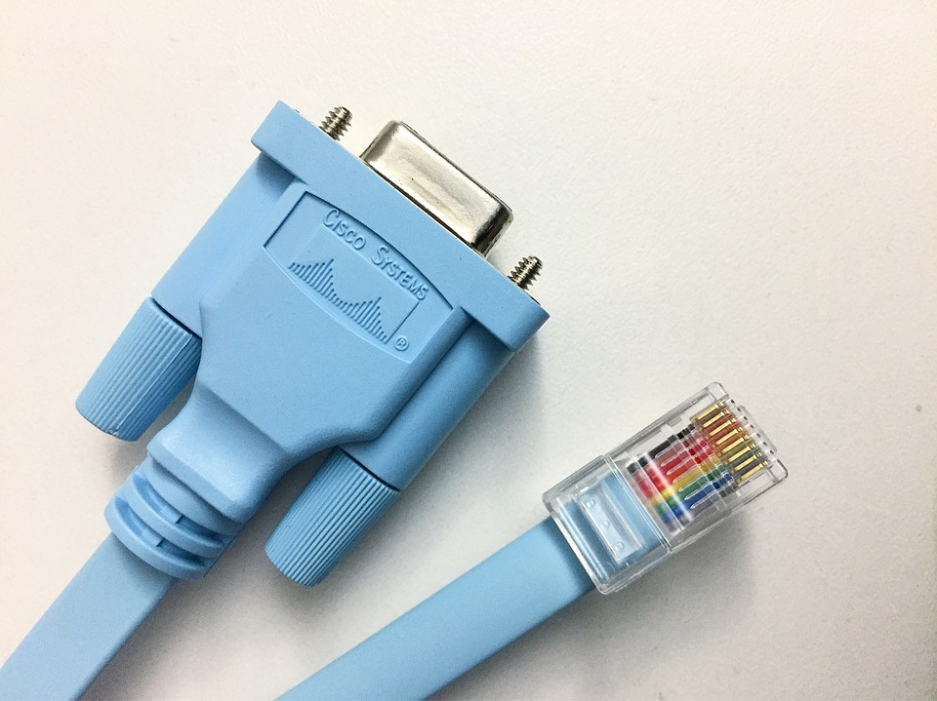
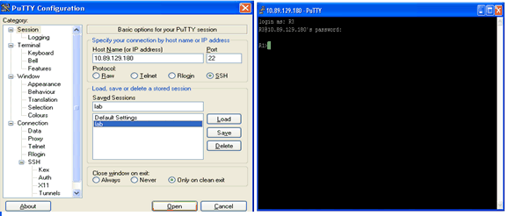
Cisco IOS Access Access Methods
Console – A physical management port used to access a device in order to provide maintenance, such as performing the initial configurations.
Secure Shell (SSH) – Establishes a secure remote CLI connection to a device, through a virtual interface, over a network. (Note: This is the recommended method for remotely connecting to a device.)
Telnet – Establishes an insecure remote CLI connection to a device over the network. (Note: User authentication, passwords and commands are sent over the network in plaintext.)

Slide 5
Terminal Emulation Programs
Terminal emulation programs are used to connect to a network device by either a console port or by an SSH/Telnet connection.
There are several terminal emulation programs to chose from such as PuTTY, Tera Term, etc
Notes:
2 – Basic Switch and End Device Configuration
2.1 – Cisco IOS Access
2.1.5 – Terminal Emulation Programs
2.1.6 – Check Your Understanding - Cisco IOS Access

Slide 6
IOS Navigation

Slide 7
IOS Navigation Primary Command Modes
User EXEC Mode:
Allows access to only a limited number of basic monitoring commands
Identified by the CLI prompt that ends with the > symbol
Privileged EXEC Mode:
Allows access to all commands and features
Identified by the CLI prompt that ends with the # symbol
Notes:
2 – Basic Switch and End Device Configuration
2.2 – IOS Navigation
2.2.1 – Primary Command Modes

Slide 8
IOS Navigation Navigation Between IOS Modes
Privileged EXEC Mode:
To move from user EXEC mode to privilege EXEC mode, use the enabled command.
Global Configuration Mode:
To move in and out of global configuration mode, use the configure terminal command. To return to privilege EXEC mode, use the exit command.
Line Configuration Mode:
To move in and out of line configuration mode, use the line command followed by the management line type. To return to global configuration mode, use the exit command.
Notes:
2 – Basic Switch and End Device Configuration
2.2 – IOS Navigation
2.2.4 – Navigate Between IOS Modes

Slide 9
The Command Structure
Notes:
2 – Basic Switch and End Device Configuration
2.3 – The Command Structure

Slide 10
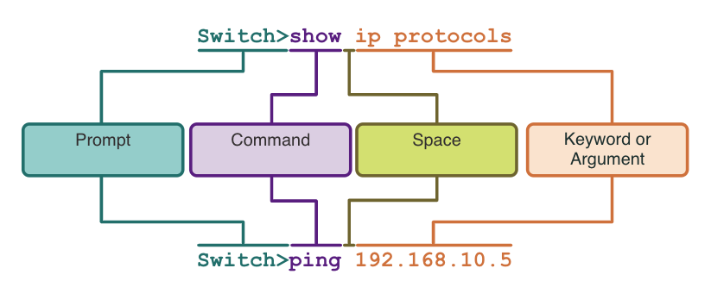
The Command Structure Basic IOS Command Structure
Keyword – This is a specific parameter defined in the operating system (in the figure, ip protocols).
Argument - This is not predefined; it is a value or variable defined by the user (in the figure, 192.168.10.5).
Notes:
2 – Basic Switch and End Device Configuration
2.3 – The Command Structure
2.3.1 – Basic IOS Command Structure

Slide 11
The Command Structure Hot Keys and Shortcuts
The IOS CLI provides hot keys and shortcuts that make configuring, monitoring, and troubleshooting easier.
Commands and keywords can be shortened to the minimum number of characters that identify a unique selection. For example, the configure command can be shortened to conf because configure is the only command that begins with conf.
Notes:
2 – Basic Switch and End Device Configuration
2.3 – The Command Structure
2.3.5 – Hot Keys and Shortcuts

Slide 12
Hot Keys and Shortcuts
When a command output produces more text than can be displayed in a terminal window, the IOS will display a “--More--” prompt. The table below describes the keystrokes that can be used when this prompt is displayed.
The table below lists commands that can be used to exit out of an operation.
Keystroke | Description
Enter Key | Displays the next line.
Space Bar | Displays the next screen.
Any other key | Ends the display string, returning to privileged EXEC mode.
Keystroke | Description
Ctrl-C | When in any configuration mode, ends the configuration mode and returns to privileged EXEC mode.
Ctrl-Z | When in any configuration mode, ends the configuration mode and returns to privileged EXEC mode.
Ctrl-Shift-6 | All-purpose break sequence used to abort DNS lookups, traceroutes, pings, etc.
Notes:
2 – Basic Switch and End Device Configuration
2.3 – The Command Structure
2.3.5 – Hot Keys and Shortcuts

Slide 13
Basic Device Configuration

Slide 14
Basic Device Configuration Device Names
The first configuration command on any device : unique hostname.
By default, all devices are assigned a factory default name. For example, a Cisco IOS switch is "Switch.”
Notes:
2 – Basic Switch and End Device Configuration
2.4 – Basic Device Configuration
2.4.1 – Device Names

Slide 15
Configure Passwords
Securing user EXEC mode access:
First enter line console configuration mode using the line console 0 command in global configuration mode.
Next, specify the user EXEC mode password using the password password command.
Finally, enable user EXEC access using the login command.
Securing privileged EXEC mode access:
First enter global configuration mode.
Next, use the enable secret password command.
Notes:
2 – Basic Switch and End Device Configuration
2.4 – Basic Device Configuration
2.4.3 – Configure Passwords

Slide 16
Configure Passwords: VTY
Securing VTY line access:
First enter line VTY configuration mode using the line vty 0 15 command in global configuration mode.
Next, specify the VTY password using the password password command.
Finally, enable VTY access using the login command.
Note: VTY lines enable remote access using Telnet or SSH to the device. Many Cisco switches support up to 16 VTY lines that are numbered 0 to 15.
Notes:
2 – Basic Switch and End Device Configuration
2.4 – Basic Device Configuration
2.4.3 – Configure Passwords

Slide 17
Encrypt Passwords
The startup-config and running-config files display most passwords in plaintext.
To encrypt all plaintext passwords, use the service password-encryption global config command.
Use the show running-config command to verify that the passwords on the device are now encrypted.
Notes:
2 – Basic Switch and End Device Configuration
2.4 – Basic Device Configuration
2.4.4 – Encrypt Passwords

Slide 18
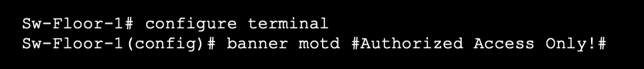
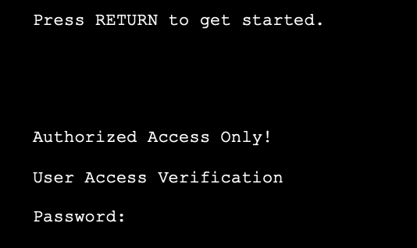
Banner Messages
A banner message is important to warn unauthorized personnel from attempting to access the device.
To create a banner message of the day on a network device, use the banner motd # the message of the day # global config command.
The banner will be displayed on attempts to access the device.
Notes:
2 – Basic Switch and End Device Configuration
2.4 – Basic Device Configuration
2.4.5 – Banner Messages

Slide 19
Save Configurations
Notes:
2 – Basic Switch and End Device Configuration
2.5 – Save Configurations

Slide 20
Save Configurations Configuration Files
There are two system files that store the device configuration:
startup-config - This is the saved configuration file that is stored in NVRAM. It contains all the commands that will be used by the device upon startup or reboot. Flash does not lose its contents when the device is powered off.
running-config - This is stored in Random Access Memory (RAM). It reflects the current configuration. Modifying a running configuration affects the operation of a Cisco device immediately. RAM is volatile memory. It loses all of its content when the device is powered off or restarted.
To save changes made to the running configuration to the startup configuration file, use:
copy running-config startup-config

Slide 21
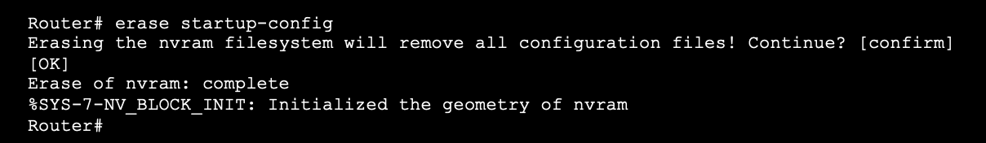
Save Configurations Alter the Running Configurations
If changes made to the running config do not have the desired effect and the running-config has not yet been saved, you can restore the device to its previous configuration. To do this you can:
Remove the changed commands individually.
Reload the device using the reload command in privilege EXEC mode. Note: This will cause the device to briefly go offline, leading to network downtime.
If the undesired changes were saved to the startup-config, it may be necessary to clear all the configurations using the erase startup-config command in privilege EXEC mode.
After erasing the startup-config, reload the device to clear the running-config file from RAM.
Notes:
2 – Basic Switch and End Device Configuration
2.5 – Save Configurations
2.5.2 – Alter the Running Configuration

Slide 22
Ports and Addresses
Notes:
2 – Basic Switch and End Device Configuration
2.6 – Ports and Addresses

Slide 23
Ports and Addresses IP Addresses
The use of IP addresses is the primary means of enabling devices to locate one another and establish end-to-end communication on the internet.
The structure of an IPv4 address is called dotted decimal notation and is represented by four decimal numbers between 0 and 255.
An IPv4 subnet mask is a 32-bit value that differentiates the network portion of the address from the host portion. Coupled with the IPv4 address, the subnet mask determines to which subnet the device is a member.
The default gateway address is the IP address of the router that the host will use to access remote networks, including the internet.
Notes:
2 – Basic Switch and End Device Configuration
2.6 – Ports and Addresses
2.6.1 – IP Addresses

Slide 24
IPv6 Addresses
IPv6 addresses are 128 bits in length and written as a string of hexadecimal values. Every four bits is represented by a single hexadecimal digit; for a total of 32 hexadecimal values. Groups of four hexadecimal digits are separated by a colon “:”.
IPv6 addresses are not case-sensitive and can be written in either lowercase or uppercase.
Notes:
2 – Basic Switch and End Device Configuration
2.6 – Ports and Addresses
2.6.1 – IP Addresses

Slide 25
Configure IP Addressing
Notes:
2 – Basic Switch and End Device Configuration
2.7 – Configure IP Addressing

Slide 26
Configure IP Addressing Manual IP Address Configuration for End Devices
End devices on the network need an IP address in order to communicate with other devices on the network.
IPv4 address information can be entered into end devices manually, or automatically using Dynamic Host Configuration Protocol (DHCP).
To manually configure an IPv4 address on a Windows PC, open the Control Panel > Network Sharing Center > Change adapter settings and choose the adapter. Next right-click and select Properties to display the Local Area Connection Properties.
Next, click Properties to open the Internet Protocol Version 4 (TCP/IPv4) Properties window. Then configure the IPv4 address and subnet mask information, and default gateway.
Note: IPv6 addressing and configuration options are similar to IPv4.
Notes:
2 – Basic Switch and End Device Configuration
2.7 – Configure IP Addressing
2.7.1 – Manual IP Address Configuration for End Devices

Slide 27
Configure IP Addressing Automatic IP Address Configuration for End Devices
DHCP enables automatic IPv4 address configuration for every end device that is DHCP-enabled.
End devices are typically by default using DHCP for automatic IPv4 address configuration.
To configure DHCP on a Windows PC, open the Control Panel > Network Sharing Center > Change adapter settings and choose the adapter. Next right-click and select Properties to display the Local Area Connection Properties.
Next, click Properties to open the Internet Protocol Version 4 (TCP/IPv4) Properties window, then select Obtain an IP address automatically and Obtain DNS server address automatically.
Note: IPv6 uses DHCPv6 and SLAAC (Stateless Address Autoconfiguration) for dynamic address allocation.
Notes:
2 – Basic Switch and End Device Configuration
2.7 – Configure IP Addressing
2.7.2 – Automatic IP Address Configuration for End Devices
2.7.3 – Syntax Checker – Verify Windows PC IP Configuration

Slide 28
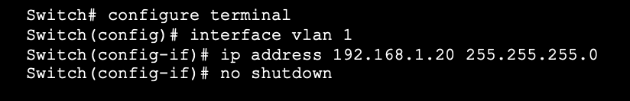
Switch Virtual Interface Configuration
To access the switch remotely, an IP address and a subnet mask must be configured on the SVI.
To configure an SVI on a switch:
Enter the interface vlan 1 command in global configuration mode.
Next assign an IPv4 address using the ip address ip-address subnet-mask command.
Finally, enable the virtual interface using the no shutdown command.
Notes:
2 – Basic Switch and End Device Configuration
2.7 – Configure IP Addressing
2.7.4 – Switch Virtual Interface Configuration
2.7.5 – Syntax Checker – Configure a Switch Virtual interface

Slide 29
Configure Router
Notes:
10 – Basic Router Configuration
10.1 Configure Initial Router Settings

Slide 30
Configure Initial Router Settings Basic Router Configuration Steps
Configure the device name.
Secure privileged EXEC mode.
Secure user EXEC mode.
Secure remote Telnet / SSH access.
Encrypt all plaintext passwords.
Provide legal notification and save the configuration.
Router(config)# hostname hostname
Router(config)# enable secret password
Router(config)# line console 0
Router(config-line)# password password
Router(config-line)# login
Router(config)# line vty 0 4
Router(config-line)# password password
Router(config-line)# login
Router(config-line)# transport input {ssh | telnet}
Router(config)# service password encryption
Router(config)# banner motd # message #
Router(config)# end
Router# copy running-config startup-config
Notes:
10 – Basic Router Configuration
10.1 – Configure Initial Router Settings
10.1.1 – Basic Routing Configuration Steps

Slide 31
Configure Initial Router Settings Basic Router Configuration Example
Commands for basic router configuration on R1.
Configuration is saved to NVRAM.
R1(config)# hostname R1
R1(config)# enable secret class
R1(config)# line console 0
R1(config-line)# password cisco
R1(config-line)# login
R1(config-line)# line vty 0 4
R1(config-line)# password cisco
R1(config-line)# login
R1(config-line)# transport input ssh telnet
R1(config-line)# exit
R1(config)# service password encryption
R1(config)# banner motd #
Enter TEXT message. End with a new line and the #
***********************************************
WARNING: Unauthorized access is prohibited!
**********************************************
R1(config)# exit
R1# copy running-config startup-config
Notes:
10 – Basic Router Configuration
10.1 – Configure Initial Router Settings
10.1.2 – Basic Routing Configuration Example
10.1.3 - Syntax Checker – Configure Initial Router Settings

Slide 32
Configure Interfaces
Notes:
10 – Basic Router Configuration
10.2 Configure Interfaces

Slide 33
Configure Interfaces Configure Router Interfaces
Configuring a router interface includes issuing the following commands:
Router(config)# interface type-and-number Router(config-if)# description description-text Router(config-if)# ip address ipv4-address subnet-mask Router(config-if)# ipv6 address ipv6-address/prefix-length Router(config-if)# no shutdown
It is a good practice to use the description command to add information about the network connected to the interface.
The no shutdown command activates the interface.
Notes:
10 – Basic Router Configuration
10.2 – Configure Interfaces
10.2.1 – Configure Router Interfaces

Slide 34
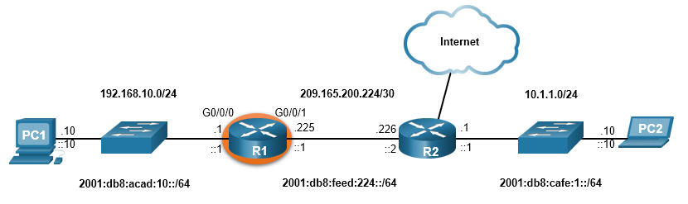
Configure Interfaces Configure Router Interfaces Example
The commands to configure interface G0/0/0 on R1 are shown here:
R1(config)# interface gigabitEthernet 0/0/0
R1(config-if)# description Link to LAN
R1(config-if)# ip address 192.168.10.1 255.255.255.0
R1(config-if)# ipv6 address 2001:db8:acad:10::1/64
R1(config-if)# no shutdown
R1(config-if)# exit
R1(config)#
*Aug 1 01:43:53.435: %LINK-3-UPDOWN: Interface GigabitEthernet0/0/0, changed state to down
*Aug 1 01:43:56.447: %LINK-3-UPDOWN: Interface GigabitEthernet0/0/0, changed state to up
*Aug 1 01:43:57.447: %LINEPROTO-5-UPDOWN: Line protocol on Interface GigabitEthernet0/0/0, changed state to up
Notes:
10 – Basic Router Configuration
10.2 – Configure Interfaces
10.2.2 – Configure Router Interfaces Example

Slide 35
Configure Interfaces Configure Router Interfaces Example (Cont.)
The commands to configure interface G0/0/1 on R1 are shown here:
R1(config)# interface gigabitEthernet 0/0/1
R1(config-if)# description Link to R2
R1(config-if)# ip address 209.165.200.225 255.255.255.252
R1(config-if)# ipv6 address 2001:db8:feed:224::1/64
R1(config-if)# no shutdown
R1(config-if)# exit
R1(config)#
*Aug 1 01:46:29.170: %LINK-3-UPDOWN: Interface GigabitEthernet0/0/1, changed state to down
*Aug 1 01:46:32.171: %LINK-3-UPDOWN: Interface GigabitEthernet0/0/1, changed state to up
*Aug 1 01:46:33.171: %LINEPROTO-5-UPDOWN: Line protocol on Interface GigabitEthernet0/0/1, changed state to up
Notes:
10 – Basic Router Configuration
10.2 – Configure Interfaces
10.2.2 – Configure Router Interfaces Example (Cont.)

Slide 36
Configure Interfaces Verify Interface Configuration
To verify interface configuration use the show ip interface brief and show ipv6 interface brief commands shown here:
R1# show ip interface brief
Interface IP-Address OK? Method Status Protocol
GigabitEthernet0/0/0 192.168.10.1 YES manual up up
GigabitEthernet0/0/1 209.165.200.225 YES manual up up
Vlan1 unassigned YES unset administratively down down
R1# show ipv6 interface brief
GigabitEthernet0/0/0 [up/up]
FE80::201:C9FF:FE89:4501
2001:DB8:ACAD:10::1
GigabitEthernet0/0/1 [up/up]
FE80::201:C9FF:FE89:4502
2001:DB8:FEED:224::1
Vlan1 [administratively down/down]
unassigned
R1#
Notes:
10 – Basic Router Configuration
10.2 – Configure Interfaces
10.2.3 – Verify Interface Configuration

Slide 37
Configure Interfaces Configure Verification Commands
The table summarizes show commands used to verify interface configuration.
Commands | Description
show ip interface brief show ipv6 interface brief | Displays all interfaces, their IP addresses, and their current status.
show ip route show ipv6 route | Displays the contents of the IP routing tables stored in RAM.
show interfaces | Displays statistics for all interfaces on the device. Only displays the IPv4 addressing information.
show ip interfaces | Displays the IPv4 statistics for all interfaces on a router.
show ipv6 interfaces | Displays the IPv6 statistics for all interfaces on a router.
Notes:
10 – Basic Router Configuration
10.2 – Configure Interfaces
10.2.4 – Configuration Verification Commands

Slide 38
Configure Interfaces Configure Verification Commands (Cont.)
View status of all interfaces with the show ip interface brief and show ipv6 interface brief commands, shown here:
R1# show ip interface brief
Interface IP-Address OK? Method Status Protocol
GigabitEthernet0/0/0 192.168.10.1 YES manual up up
GigabitEthernet0/0/1 209.165.200.225 YES manual up up
Vlan1 unassigned YES unset administratively down down
R1#
R1# show ipv6 interface brief
GigabitEthernet0/0/0 [up/up]
FE80::201:C9FF:FE89:4501
2001:DB8:ACAD:10::1
GigabitEthernet0/0/1 [up/up]
FE80::201:C9FF:FE89:4502
2001:DB8:FEED:224::1
Vlan1 [administratively down/down]
unassigned
R1#
Notes:
10 – Basic Router Configuration
10.2 – Configure Interfaces
10.2.4 – Configuration Verification Commands (Cont.)

Slide 39
Configure Interfaces Configure Verification Commands (Cont.)
Display the contents of the IP routing tables with the show ip route and show ipv6 route commands as shown here:
R1# show ip route
< output omitted>
Gateway of last resort is not set
192.168.10.0/24 is variably subnetted, 2 subnets, 2 masks
C 192.168.10.0/24 is directly connected, GigabitEthernet0/0/0
L 192.168.10.1/32 is directly connected, GigabitEthernet0/0/0
209.165.200.0/24 is variably subnetted, 2 subnets, 2 masks
C 209.165.200.224/30 is directly connected, GigabitEthernet0/0/1
L 209.165.200.225/32 is directly connected, GigabitEthernet0/0/1
R1#
R1# show ipv6 route
<output omitted>
C 2001:DB8:ACAD:10::/64 [0/0]
via GigabitEthernet0/0/0, directly connected
L 2001:DB8:ACAD:10::1/128 [0/0]
via GigabitEthernet0/0/0, receive
C 2001:DB8:FEED:224::/64 [0/0]
via GigabitEthernet0/0/1, directly connected
L 2001:DB8:FEED:224::1/128 [0/0]
via GigabitEthernet0/0/1, receive
L FF00::/8 [0/0]
via Null0, receive
R1#
Notes:
10 – Basic Router Configuration
10.2 – Configure Interfaces
10.2.4 – Configuration Verification Commands (Cont.)

Slide 40
Configure Interfaces Configure Verification Commands (Cont.)
Display IPv4 statistics for router interfaces with the show ip interface command, as shown here:
R1# show ip interface g0/0/0
GigabitEthernet0/0/0 is up, line protocol is up
Internet address is 192.168.10.1/24
Broadcast address is 255.255.255.255
Address determined by setup command
MTU is 1500 bytes
Helper address is not set
Directed broadcast forwarding is disabled
Outgoing Common access list is not set
Outgoing access list is not set
Inbound Common access list is not set
Inbound access list is not set
Proxy ARP is enabled
Local Proxy ARP is disabled
Security level is default
Split horizon is enabled
ICMP redirects are always sent
ICMP unreachables are always sent
ICMP mask replies are never sent
IP fast switching is enabled
IP Flow switching is disabled
<output omitted>
R1#
Notes:
10 – Basic Router Configuration
10.2 – Configure Interfaces
10.2.4 – Configuration Verification Commands (Cont.)

Slide 41
Topics Learned
The tasks that should be completed when configuring initial settings on a router.
Configure the device name.
Secure privileged EXEC mode.
Secure user EXEC mode.
Secure remote Telnet / SSH access.
Secure all passwords in the config file.
Provide legal notification.
Save the configuration.
For routers to be reachable, the router interfaces must be configured.
Using the no shutdown command activates the interface. The interface must also be connected to another device, such as a switch or a router, for the physical layer to be active. There are several commands that can be used to verify interface configuration including the show ip interface brief and show ipv6 interface brief, the show ip route and show ipv6 route, as well as show interfaces, show ip interface and show ipv6 interface.

Slide 42
New Terms and Commands
show ip interface brief show ipv6 interface brief show ip route show ipv6 route show interfaces show ip interface show ipv6 interface ip default-gateway

